Slide 1

BEAUTIFY
29-05-2020

Slide 2
INDEX
INTRODUCTION
HAAR CASCADE FOR FACIAL DETECTION
FEATURES
MOUSTACHE
RED EYE REMOVER
SPECTACLES
BLEMISH REMOVER
LIPSTICK
REFERENCES

Slide 3
INTRODUCTION
In the era of Instagram and selfie obsession, face beautification software is on top of trends.
While virtual makeovers allow you to try on cosmetics products via your mobile camera, the digital face beautification software can hide your imperfections and enhance the picture
.
One can also customize personal styles by enhancing the quality of images using the features present.
It's mechanism makes the working of the project efficiently understandable and convenient to transform.
This is performed by detecting the face and eyes from an image using OpenCV and Pillow to manipulate the pictures.
However, there are multiple methods in which facial recognition systems work,in general, Face detection is performed by using classifiers. A classifier is essentially an algorithm that decides whether a given image is positive(face) or negative(not a face). Fortunately, OpenCV already has two pre-trained face detection classifiers, which can readily be used in a program.

Slide 4
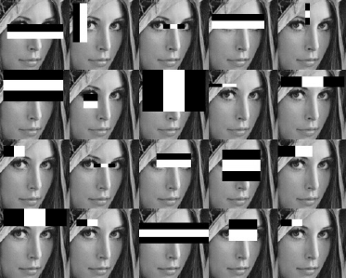
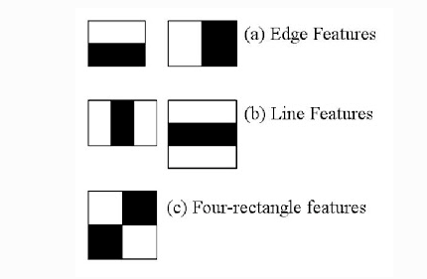
HAAR CASCADE FOR FACIAL DETECTION
To begin with, the classification is generally done by extracting Haar features from each image.
Haar classifier employs Integral Image concept which allows the features used by the detector to be computed very quickly.
Haar Features are kind of convolution kernels which primarily detect whether a suitable feature is present on an image or not.
Haar Features:
Each feature results in a single value which is calculated by subtracting the sum of pixels under white rectangle from the sum of pixels under black rectangle.
Every haar feature have some sort of resemblance to identify a part of face.

Slide 5
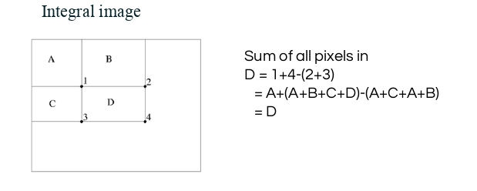
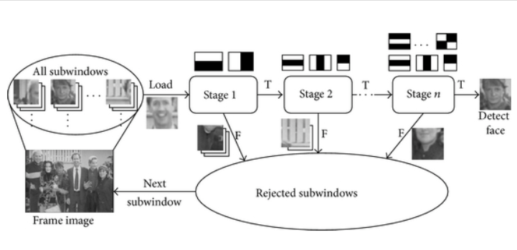
Integral Images: This means, to find the sum of all pixels under any rectangle, we would need the four corner values.
The above figure helps us to calculate the sum of pixels in any feature window.
Cascade Classifiers: It essentially consists of stages where each stage consists of a strong classifier.

Slide 6
It eliminates the need to apply all features at once on a window, which allows the algorithm to perform faster.
This groups the features into separate sub-windows and determine face at each stage.
The process continues until a face is detected else the sub-window is now discarded along with its features.
After detecting a face, the sub-window moves past the classifier, it continues to the next stage where the second stage of features are applied.
fig: viola-jones face detection algorithm.

Slide 7
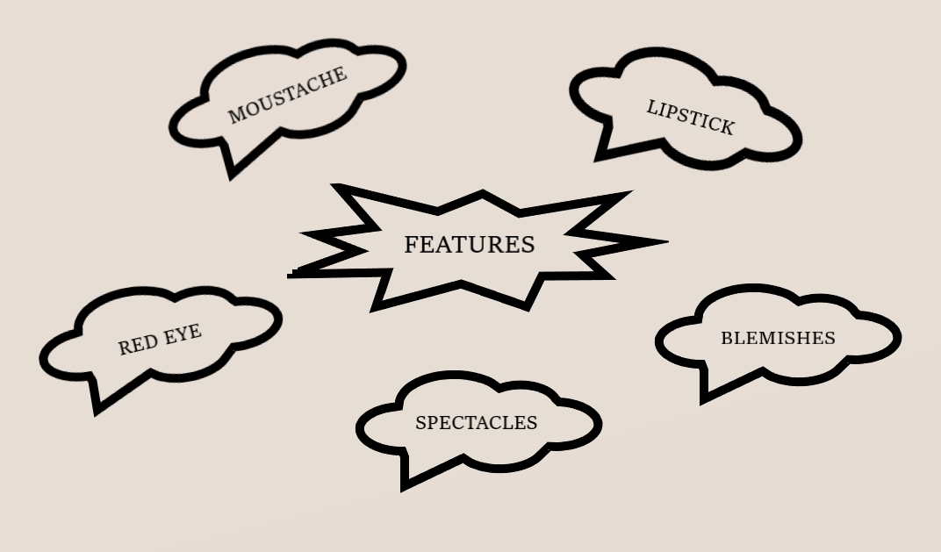
FEATURES
Towards the direction in the fulfillment of our mission, we would require a commitment of varied skills and resources. During the construction phase, all these resources are pooled together to achieve a specific purpose.
The following are the 5 essential features that are majorly focused while implementing modifications to the images:

Slide 8
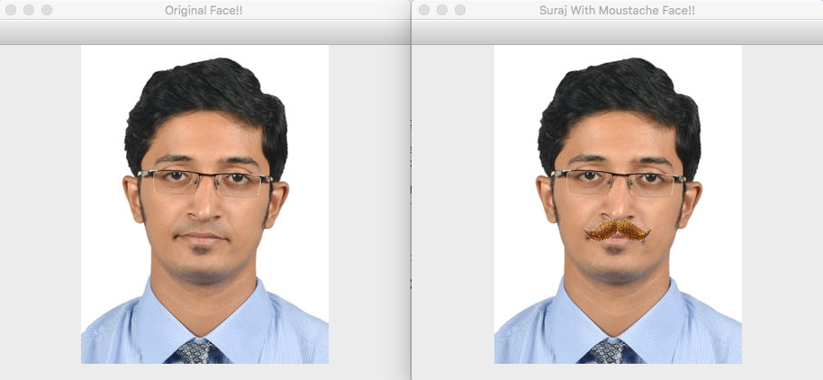
MOUSTACHE
Here, we are using the Python bindings for OpenCV in order to draw a scaled mustache over an image.
The images below is the output, where the comparison of the before and after appending a moustache can be seen.

Slide 9
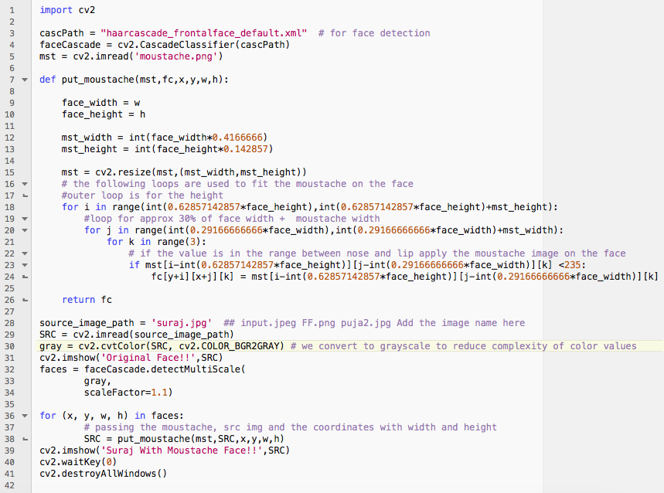
CODE:

Slide 10
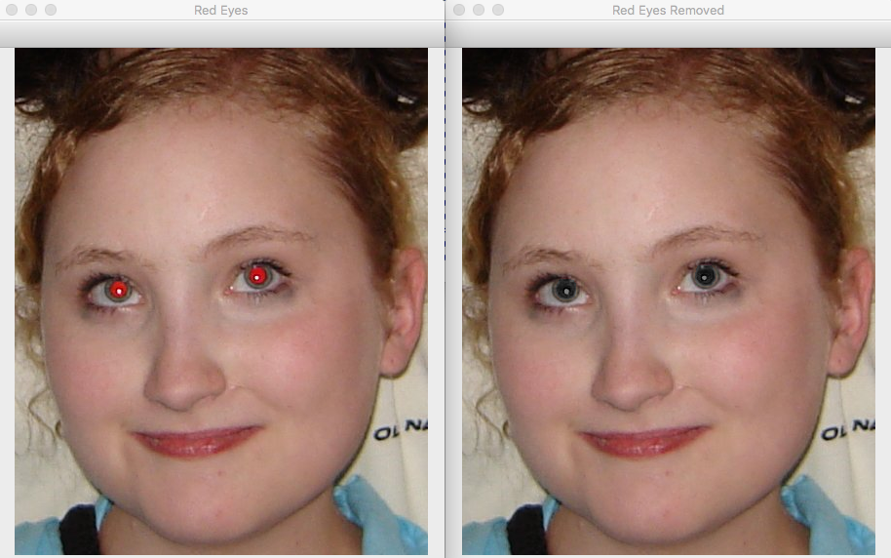
RED EYE REMOVAL

Slide 11
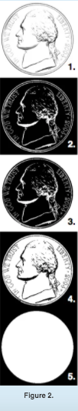
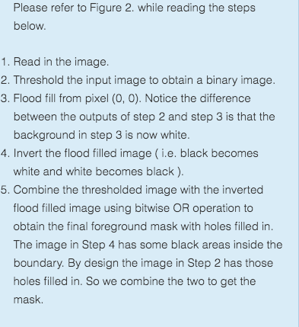
FILLING HOLES IN AN IMAGE USING OPENCV
Let’s say we want to find a binary mask that separates the coin from the background as
shown in the left image
So, we use simple image thresholding to separate the boundary from the background.
In other words, we say pixels with intensities above a certain value ( threshold )
are the background and the rest are the foreground
We know the pixel (0,0) is connected to the background. So we can extract the background, by simply doing a floodfill operation from pixel (0, 0).

Slide 12
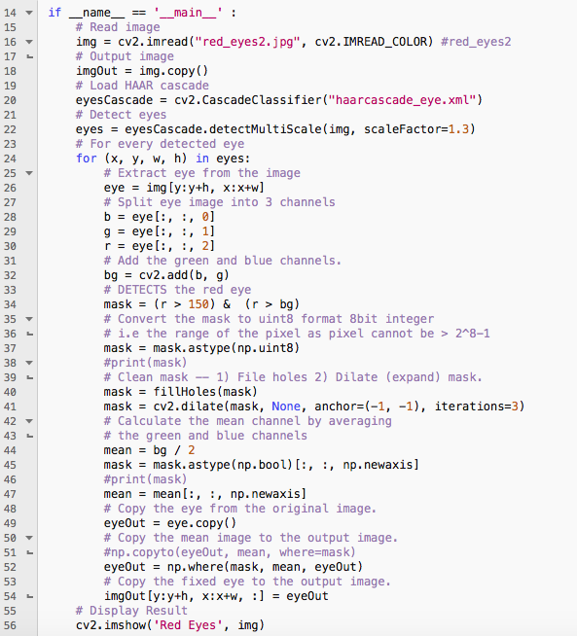
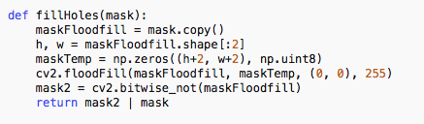
CODE:

Slide 13
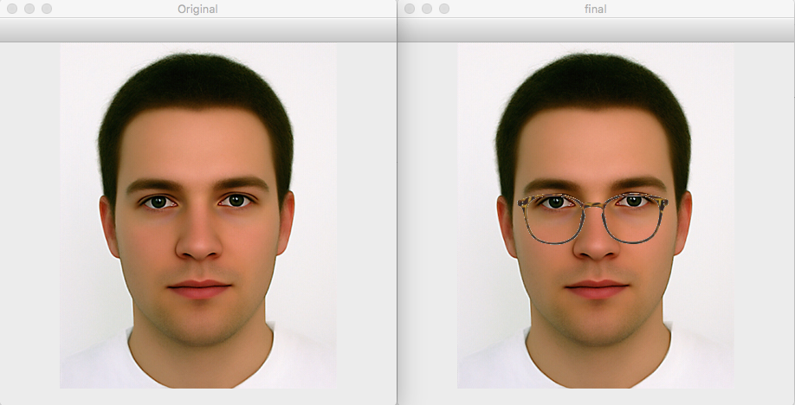
SPECTACLES

Slide 14
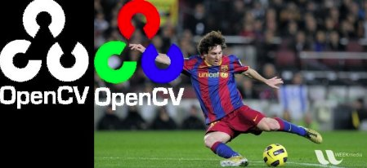
BITWISE_AND
It is highly useful while extracting any part of the image, defining and working with
non-rectangular ROI's, and etc. Below we will see an example of how to change a particular
region of an image.
Example:
We want to put logo on top-left corner, So I create a ROI
Now create a mask of logo and create its inverse mask also
img2gray = cv.cvtColor(img2,cv.COLOR_BGR2GRAY)
ret, mask = cv.threshold(img2gray, 10, 255, cv.THRESH_BINARY)
mask_inv = cv.bitwise_not(mask)
Now black-out the area of logo in ROI
img1_bg = cv.bitwise_and(roi,roi,mask = mask_inv)
Take only region of logo from logo image.
img2_fg = cv.bitwise_and(img2,img2,mask = mask)
Put logo in ROI and modify the main image
dst = cv.add(img1_bg,img2_fg)
img1[0:rows, 0:cols ] = dst

Slide 15
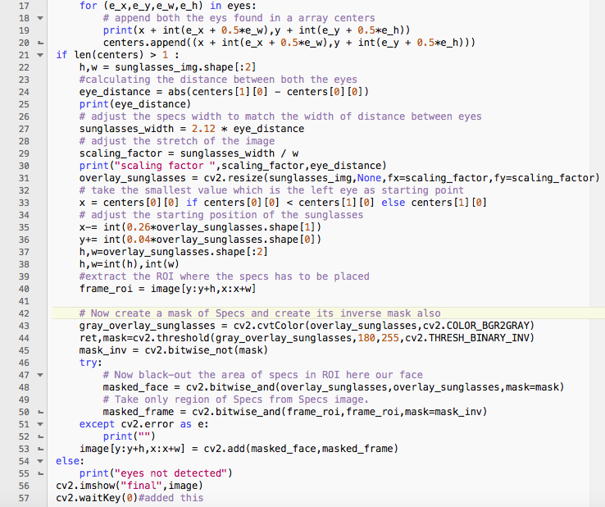
CODE:

Slide 16
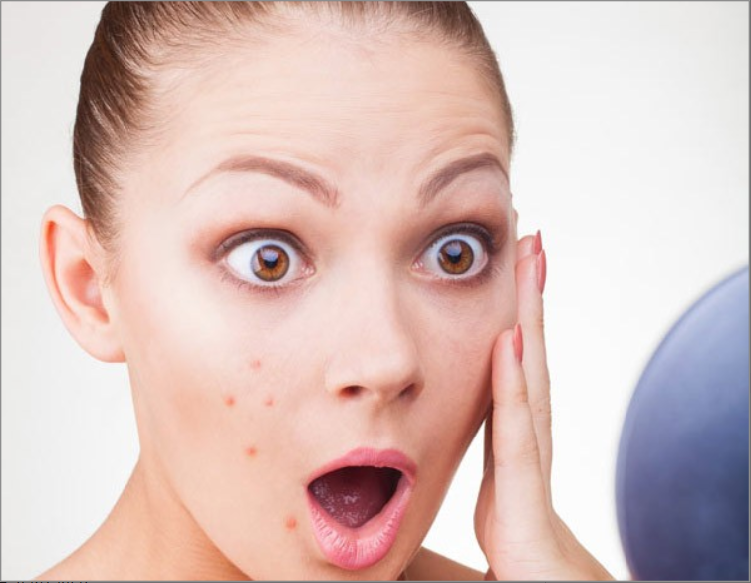

BLEMISH REMOVER
BEFORE AFTER

Slide 17
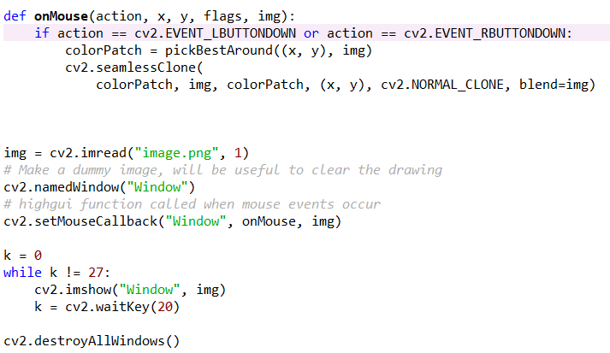
CODE:

Slide 18
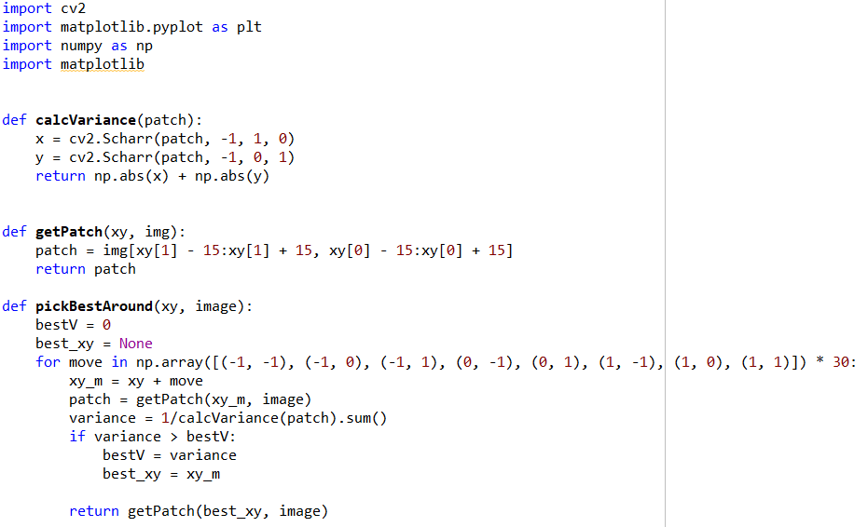
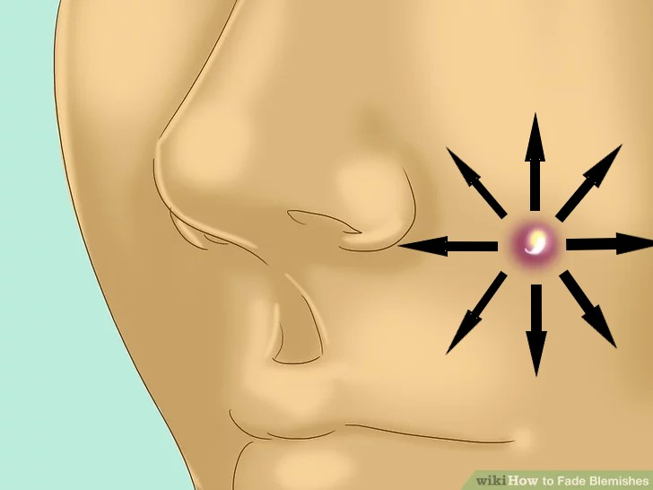

Slide 19
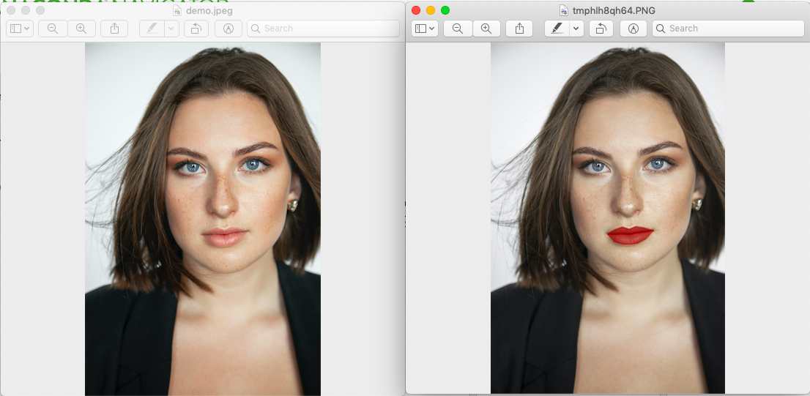
LIPSTICK

Slide 20

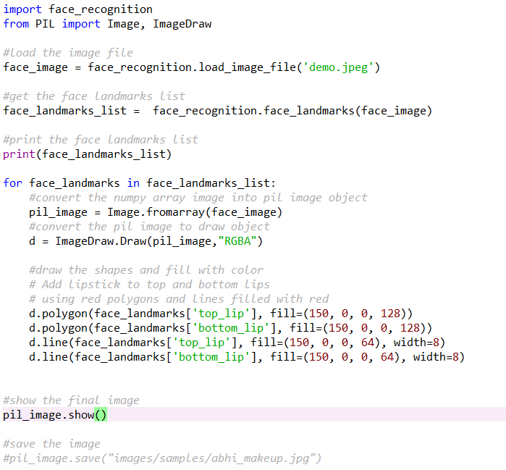
CODE:

Slide 21
REFERENCES
:
https://pillow.readthedocs.io/en/3.0.x/handbook/tutorial.html
http://students.iitk.ac.in/eclub/assets/tutorials/OPENCV%20TUTORIAL.pdf
https://www.pyimagesearch.com/2017/04/03/facial-landmarks-dlib-opencv-python/
https://docs.opencv.org/3.4/db/d28/tutorial_cascade_classifier.html
https://www.tutorialspoint.com/opencv/opencv_scharr_operator.htm
https://www.learnopencv.com/filling-holes-in-an-image-using-opencv-python-c/
https://www.learnopencv.com/opencv-threshold-python-cpp/
https://docs.opencv.org/2.4/modules/imgproc/doc/miscellaneous_transformations.html?highlight=floodfill
https://docs.opencv.org/2.4/modules/imgproc/doc/filtering.html?highlight=dilate#void%20dilate(InputArray%20src,%20OutputArray%20dst,%20InputArray%20kernel,%20Point%20anchor,%20int%20iterations,%20int%20borderType,%20const%20Scalar&%20borderValue)
https://docs.opencv.org/trunk/d0/d86/tutorial_py_image_arithmetics.html
https://www.datacamp.com/community/tutorials/face-detection-python-opencv
https://medium.com/@me.satyam/haar-cascade-face-identification-aa4b8bc79478
https://docs.opencv.org/master/d0/d86/tutorial_py_image_arithmetics.html

Slide 22
Thank You

